Slide 1

Predicting Public School Teacher Retention Using NCES Public Data
June Yu
CS5395
Spring 2022

Slide 2

Leaving or Staying?
What to Solve?
America’s crisis in teacher shortage in public schools
How to Solve?
Use public-use survey data and a machine learning approach
Identify the strongest predictors of the teacher’s retention rate
Predict whether a teacher leaves or stays

Slide 3
NCES Data School and Staffing Survey (SASS) Teacher Follow-Up Survey (TFS)
National Center for Education Statistics (NCES) is collecting and analyzing data related to education in the U.S.
NCES conducted SASS from 1997 to 2011 to study K-12 educator labor market
SASS 1999-2000 is available for public-use
TFS was conducted a year after(2000-2001) the SASS 1999-2000
TFS determines how many teachers remained or left teaching
SASS and TFS covered topics such as:
teacher demand
teacher and principal characteristics
general school conditions,
principals' and teachers' perceptions of school climate
teacher compensation
district hiring and retention practices
basic characteristics of the student population

Slide 4







Data Integration
Label:
Former Teacher
(1679, 404)
3,640 Teachers
151 Features
(42086, 1335)
(8432, 814)
(8524, 473)
‘CNTLNUM’
‘SCHCNTL’
‘SCHCNTL’
‘SCHCNTL’
Label:
Current Teacher
(2477, 618)

Slide 5
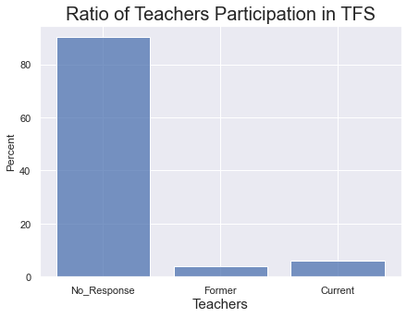
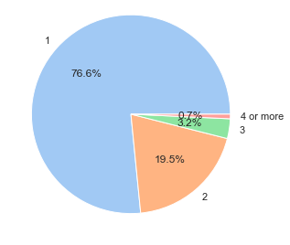
Exploratory Data Analysis How many teachers and schools?
Number of Teachers per School
Ratio of Teachers Participation in TFS
Initially, 42,086 public teachers from SASS
4,156(10%) of the teachers participated in TFS
Among 4,156 teachers, some teachers do not have associated principal
2,477 current, 1,679 former teachers
Total 3,640 teachers working for 2,838 schools are analyzed,
Average 1.28 teachers per school
76.6% of schools has 1 teacher participated in SASS and TFS

Slide 6
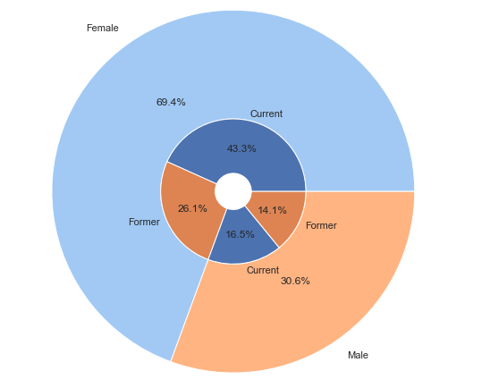
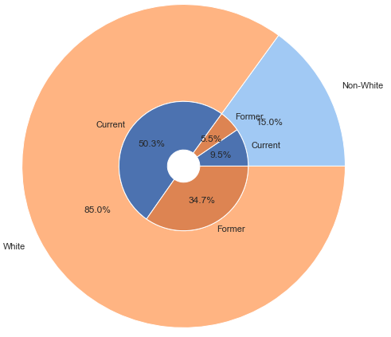
Exploratory Data Analysis Teachers Gender and Race/Ethnicity
Gender – Female, Male
Race/Ethnicity – White, Non-White
White(Non-Hispanic) teachers are the majority race/ethnicity compared to Hispanic, Black, American Indian or Alaska Native, and Asian or Pacific Islander
Turnover rate is higher for White teachers
Female teachers are 2/3 of the teacher samples
Turnover rate is higher for male teachers

Slide 7
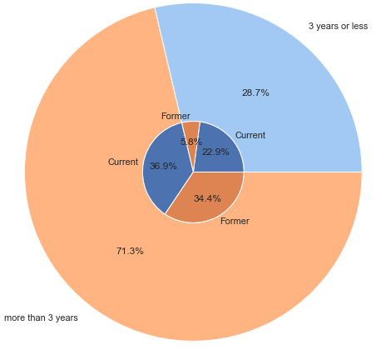
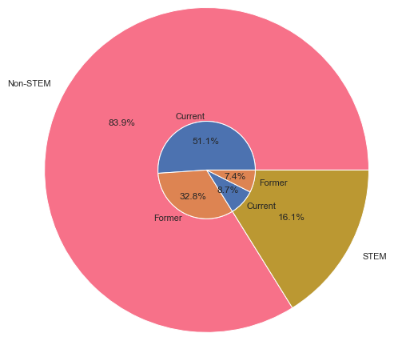
Exploratory Data Analysis Teaching Experiences
New Teacher Flag
Teaching Assignment Field
Teachers working more than 3 years have significantly higher turnover rate than new teachers
Teachers taught STEM subjects are small, 16%, but have higher turnover rate

Slide 8



Machine Learning Approach Learning Process
Classification with ML Models
Modeling
Model Selection
Current Teacher
Former Teacher
Input
Output
Feature Engineering
Correlation Filtering
Shrinkage Methods

Slide 9
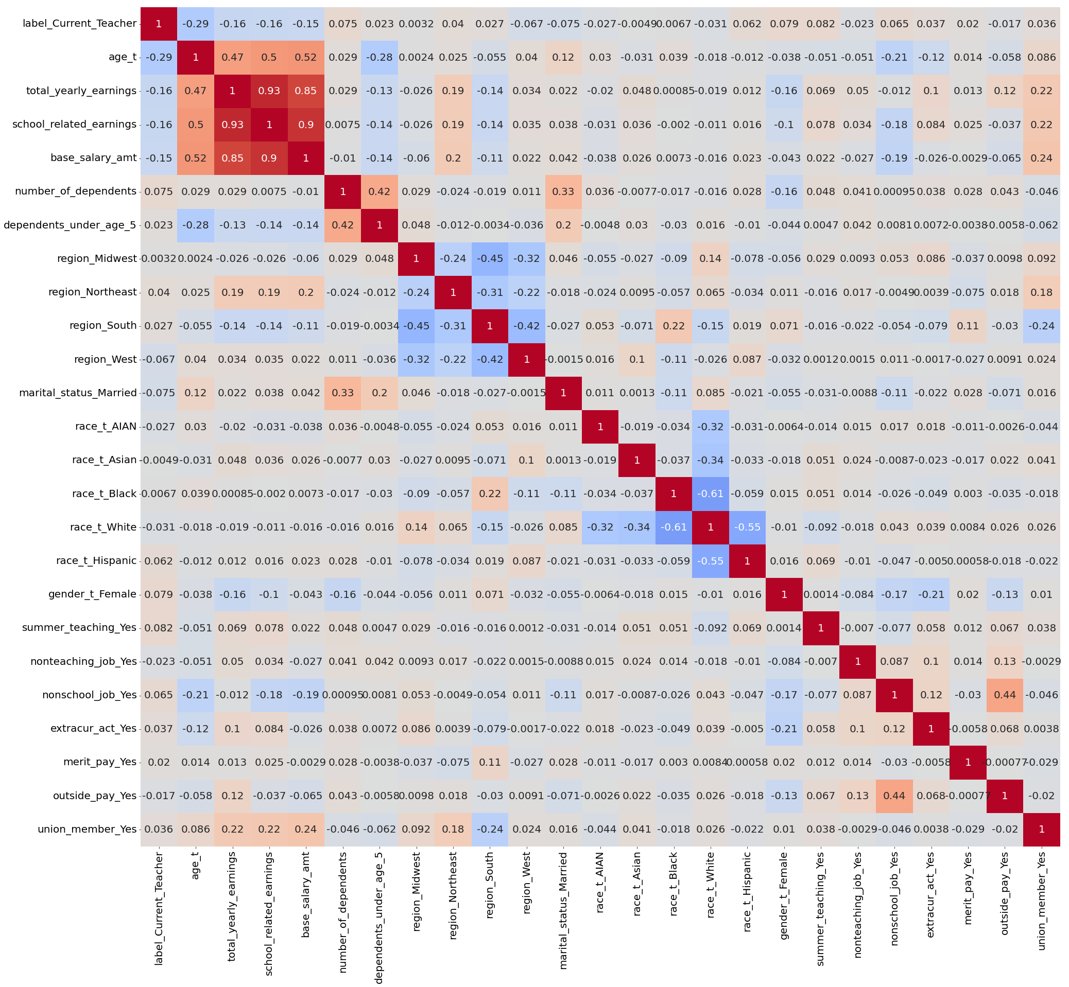

Feature Selection from 151 Features Correlation Filtering
Any pairs of features correlated positively
Any two features correlated negatively
Aggregated related multiple features into integrated one
e.g. math_hours_taught, science_hours_taught
are aggregated into STEM_hours_taught
OR
Eliminated one of the correlated pairs
if its correlation with our target label is lower
e.g.
number_of_dependents vs. dependents_under_age_5
51 features are selected

Slide 10
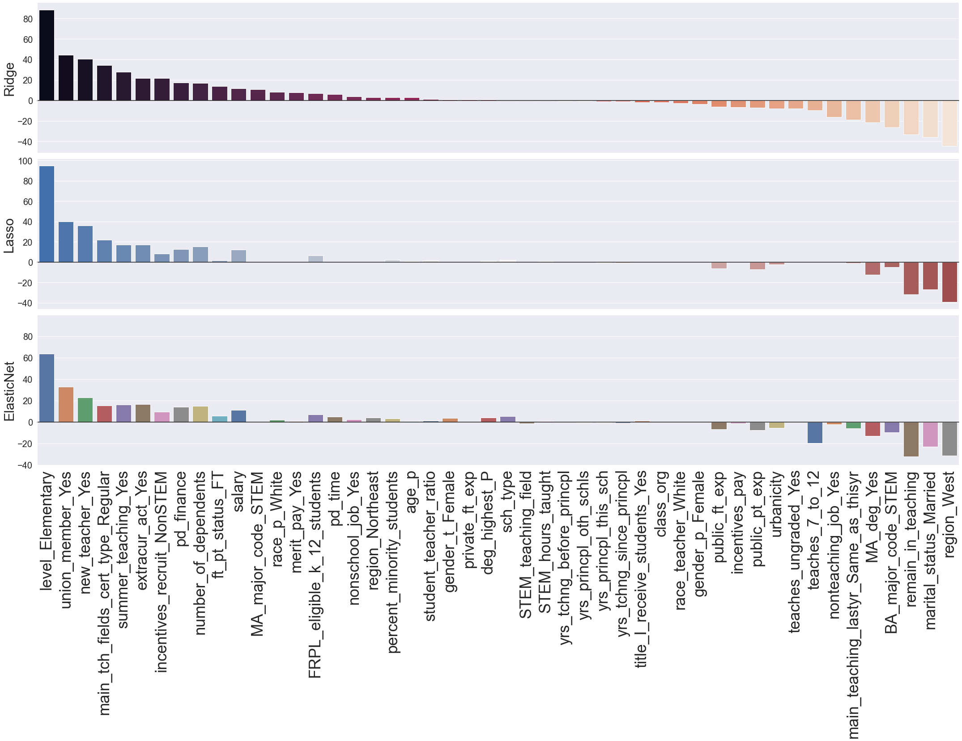
Feature Selection from 53 Features Shrinkage Methods
Ridge Regression
3 models are used: the models forces less important features to be reduced towards zero
Ridge, as base, is compared with Lasso which shrinks coefficients to be exactly zero
Elastic Net combines both Ridge and lasso as it reduces the impact of feature, not eliminating them
Lasso Regression
selected 31 features
Some features we assumed the impact would be strong indicates weakness
student_teacher_ratio
STEM_teaching_field
gender_t_Female (Teacher’s gender)
STEM_hours_taught
title_I_receive_students_Yes
FRPL_eligible_k_12_students
race_t (Teacher’s race)
race_P (Principal’s race)
Elastic-Net Regression
selected 47 features
51 features are remained after removing 2 features
Top 3:
level_Elementary, union_member_Yes, new_teacher_Yes
Bottom 3:
region_West, marital_status_Married,
remain_in_teaching
Eliminated:
class_org, teaches_ungraded_Yes

Slide 11
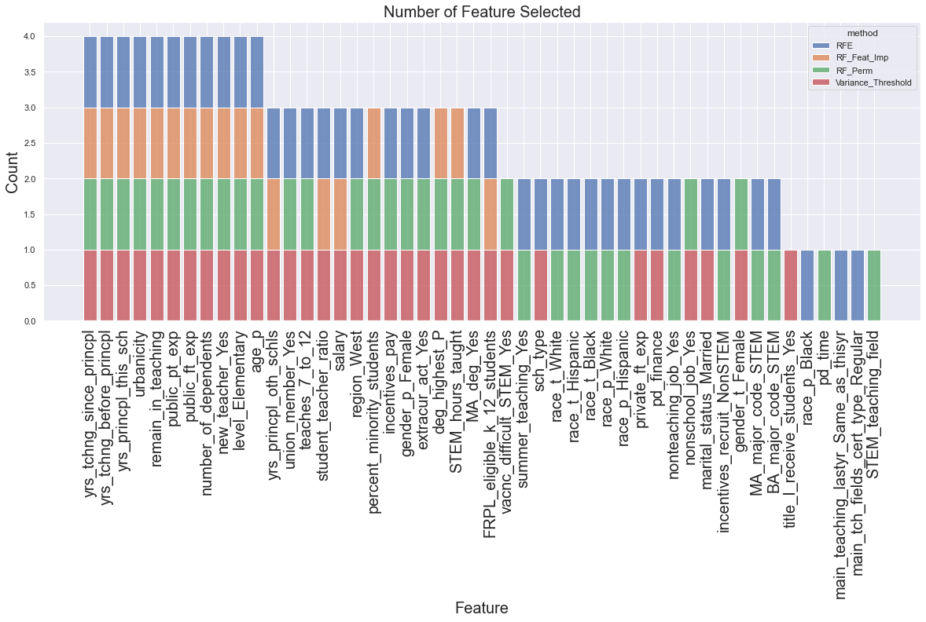
Feature Importance Dimensionality Reduction
To train machine learning models, 4 dimensionality methods are experimented to reduce dimensionality
Number of Feature Selected
Method #1. Variance Threshold
To drop any feature containing similar values
With Threshold 0.8*(1-0.8): a feature includes 80% of the same value and 20% of other values
n_feature_selected: 33
Method #2. Recursive Feature Elimination (RFE)
Run with Ridge regression
With cross-validation with 10-fold for n range from 1 to 51
n_feature_selected: 39
Method #3. Random Forest Feature Importance
Drops a feature importance lower than 0.015
n_feature_selected: 18
Method #4. Permutation Importance
Run with Random forest
n_feature_selected: 36

Slide 12
Machine Learning Classifier Modeling – 7 Models
7 models have been selected and built for comparison purpose
Linear or decision tree-based(boosting, gradient descent)
Train and test set is split with ratio 8:2 with shuffling and stratification on the label
All 7 models were run with 6 different sets of the predictors we selected
n_selected=[18, 33, 36, 39, 51]
Each model was run with 10-fold cross-validation and GridSearch to find the best hyper-parameters
Results are evaluated to select the best model and predictors based on performance metrics
Model #1. Ridge Regression
'C': [0.001, 0.01, 0.1, 1, 10, 100]
Model #5. Random Forest
'max_depth': [1,3,5,7,9,None]
Model #2. KNN
'n_neighbors': [1,3,5,7,9,11]
Model #6. Gradient Boosting
'learning_rate': [0.01, 0.1, 1]
'max_depth': [1,3,5,None]
Model #3. SVM(Linear)
'C': [0.01, 0.1, 1, 5, 10]
Model #7. Stochastic Gradient Descent
'alpha': [0.001, 0.01, 0.1, 1, 10, 100]
Model #4. SVM(Kernel)
'C': [0.01, 0.1, 1, 5, 10]

Slide 13
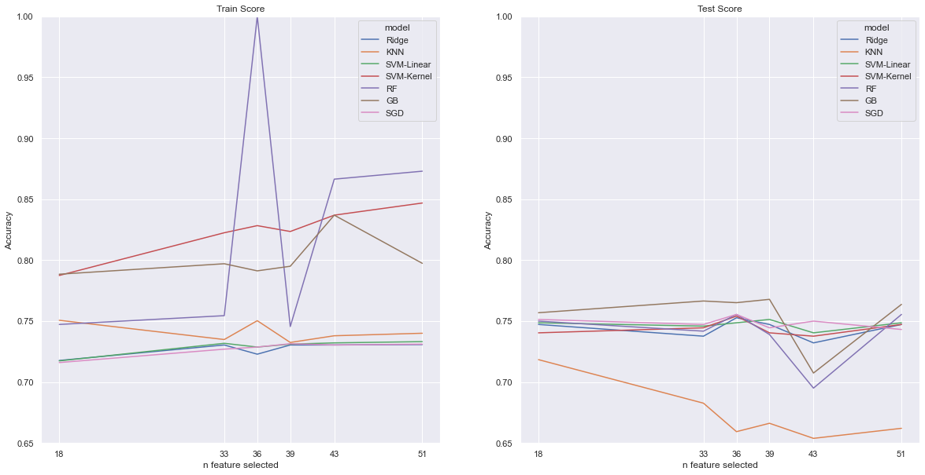
Evaluation Best Predictors
Train Score
Test Score
First, we compared accuracy score on the train and test sets to select the best set of predictors
Train set scores increased and peaked at n size 36 and 43, and test set scores decreased after n size 36
These score discrepancy indicates overfitting of the model
We select n size 18 the best predictor set to avoid the overfitting

Slide 14
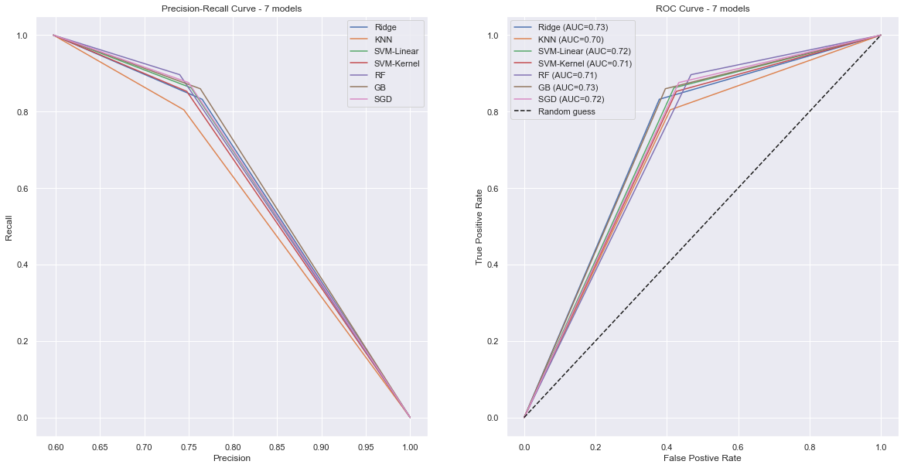
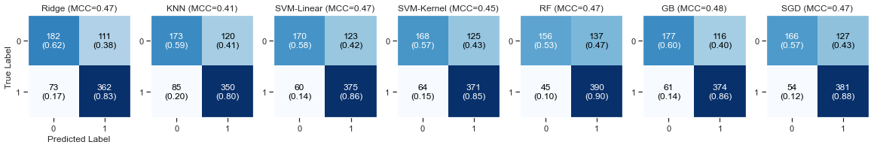
Evaluation Best Model
Confusion Matrix
Precision-Recall Curve
ROC Curve
0: Former
1: Current
We examined confusion matrix, precision, recall, ROC(AUC), and MCC score for the best predictor set, n size 18
Random Forest, GradientBoosting, SGD are better performing regarding high recall and precision
GradientBoosting is the best in terms of balanced accuracy, the highest MCC score and AUC area

Slide 15
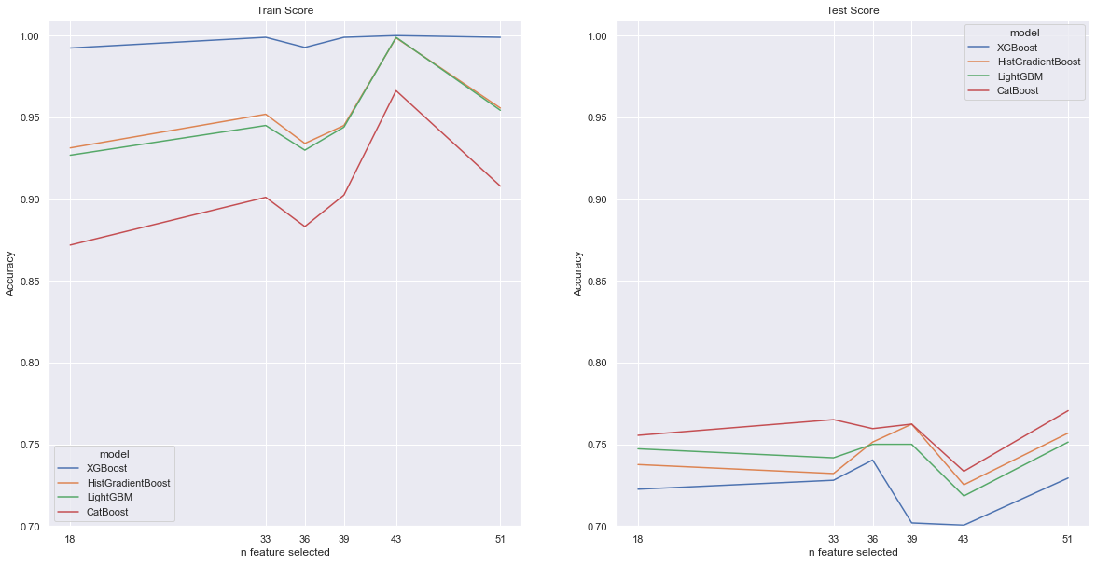
Experiments Improved Gradient Boosting models
Gradient Boosting models’ performance was the best among the 7 baseline models
The same modeling process with 6 different predictor sets was demonstrated with optimized gradient boosting models such as XGBoost, HistGradientBoosting, LightGBM, and CatBoost without hyper-parameter tuning
Train Score
Test Score
Train accuracy is much higher, but test accuracy is slightly higher compared to the baseline models
Further experiments with hyper-parameter tuning is required as tree-based models are prone to be overfitting
Among 4 gradient boosting models, CatBoost shows the best train score
The best predictor set, n size 18 is still the best set with the gradient boosting models

Slide 16
Conclusion Best Predictors
Initially, 151 features were picked from, then reduced to 53 features using correlation filtering
Using shrinkage methods, 51 features were selected
Top 18 predictors are selected from the baseline models and the gradient boosting model experiment
7 predictors are from Public Teacher and Public Principal respectively, and 4 predictors are from Public School component
Feature | Component | Description
public_ft_exp | Public Teacher | Years of working as a FULL-TIME elementary or secondary teacher in PUBLIC schools
student_teacher_ratio | Public Teacher | Number of students per full-time equivalent teacher in the school.
remain_in_teaching | Public Teacher | Teacher's plan to remain in teaching
yrs_tchng_before_princpl | Public Principal | Years of elementary or secondary teaching experience PRIOR to becoming a principal
yrs_princpl_this_sch | Public Principal | Years of employment as the principal of THIS school
yrs_princpl_oth_schls | Public Principal | Years of employment as the principal of OTHER school
number_of_dependents | Public Teacher | Number of persons, including children, dependent upon for more than half of their financial support
salary | Public Principal | Current ANNUAL salary for your position in this school before taxes and deductions
level_Elementary | Public School | School level based on school reported grade levels offered
age_p | Public Principal | Principal's age
STEM_hours_taught | Public Teacher | Approximately hours of teaching Mathematics and Science for most recent FULL WEEK
new_teacher_Yes | Public Teacher | Teacher has taught 3 years or less, including part-time and full-time teaching
FRPL_eligible_k_12_students | Public School | Number of students ELIGIBLE for free or reduced-price lunches
percent_minority_students | Public School | Percent of minority students at this school
yrs_tchng_since_princpl | Public Principal | Years of elementary or secondary teaching experience SINCE becoming a principal
urbanicity | Public School | Physical location of school
deg_highest_P | Public Principal | The highest degree the principal has earned
public_pt_exp | Public Teacher | Years of working as a PART-TIME elementary or secondary teacher in PUBLIC schools

Slide 17
Conclusion Best Model
7 models, Ridge Regression, KNN, SVM (Linear), SVM(Kernel), Random Forest, Gradient Boosting, SGD, have been built
Overall, tree-based models, Random Forest, Gradient Boosting, SGD, demonstrated better accuracy and precision-recall
These 7 models can be utilized as our baseline models for further experiments
Improved Gradient Boosting models, XGBoost, HistGradientBoosting, LightGBM, and CatBoost, perform better, but they tend to be overfitting

Slide 18

Next Step
Gradient Boosting Algorithms
Continue to experiment on the gradient boosting models for optimization with hyper-parameters
Deep Learning
So far, data transformation, feature extraction, and feature selected were manually designed for the traditional machine learning models
We revisit initial 151 features and build deep learning model models such as Multilayer perceptron to represent complex features
A simple neural network model with 1 dense layer is experimented on 151 features to examine future work using Tensorflow and Keras:
1 dense layer with 130 neurons ReLU
Sigmoid activation function
Binary cross entropy loss function
100 epochs
The simple NN shows overfitting, thus optimization is also required for the number of neurons, activation function, and loss/cost functions
Hybrid Gradient Boosting and Neural Network
Once we find the best gradient boosting and neural network models, we can blend those two models and analyze

Slide 19
Thank You!

